Slide 1


UTOPIA
Home
Photo
About Us
Contact
UTOPIA
WWW.REALLYGREATSITE.COM
01

Slide 2
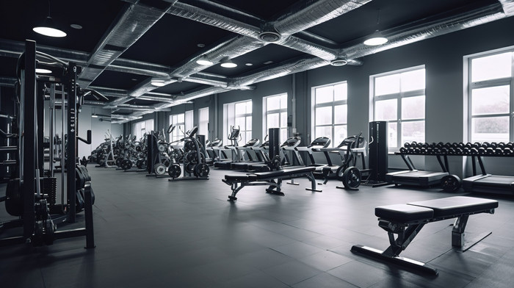

UTOPIA
Home
Photo
About Us
Contact
WELCOME TO UTOPIA
Welcome to your gym's digital hub! Our website simplifies daily tasks, from managing memberships and scheduling classes to communicating with members and analyzing your business performance.
02

Slide 3
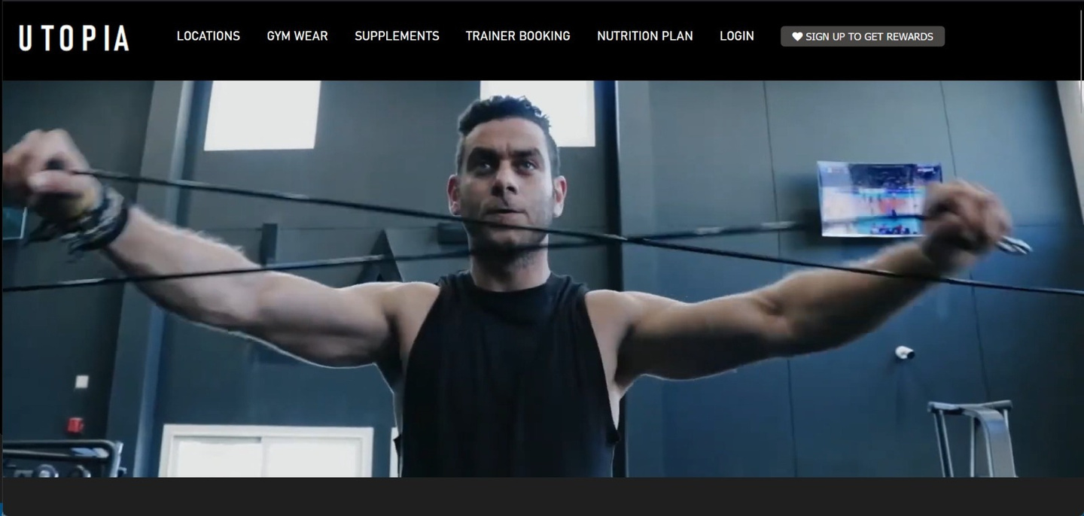

UTOPIA
Home
Photo
About Us
Contact
ABOUT OUR SITE
About UTOPIA
Improve efficiency: By automating tasks like membership management, billing, and scheduling, the website saves time and reduces administrative overhead for gym staff.
Enhance member experience: Providing members with online access to manage their memberships, book classes, and communicate with the gym improves convenience and satisfaction.
Increase revenue: By optimizing operations, improving member retention, and facilitating marketing efforts, the website can contribute to increased revenue for the gym.
03

Slide 4
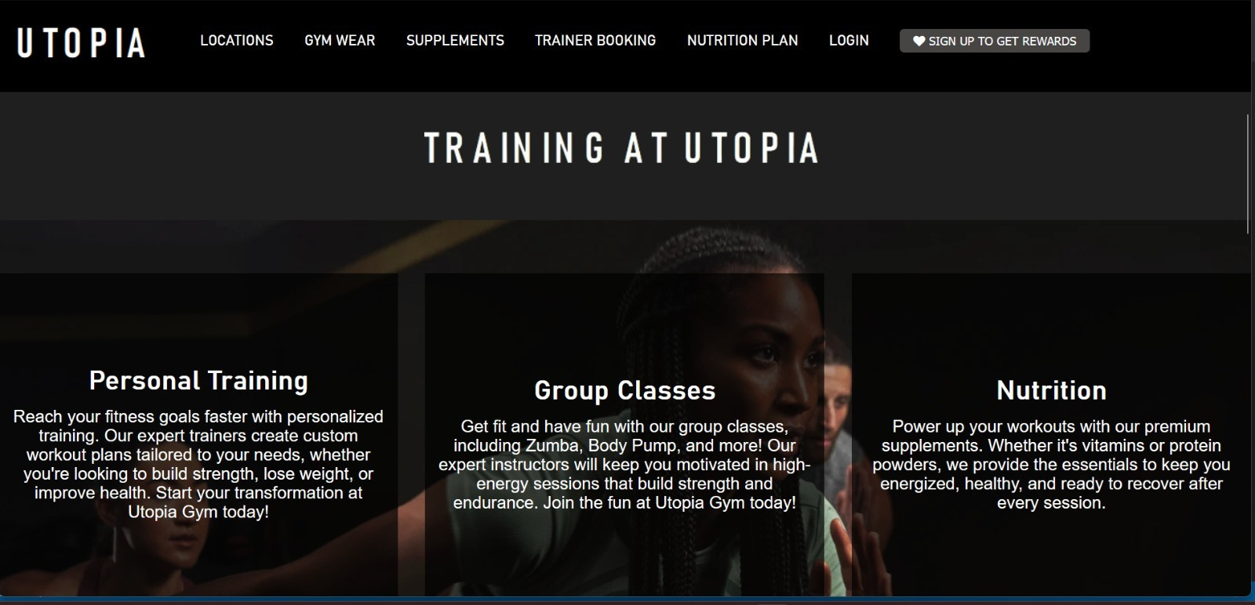
UTOPIA
Home
Photo
About Us
Contact
WHAT OUR SITE PROVIDES
04

Slide 5



UTOPIA
Home
Photo
About Us
Contact
OUR VISION
Membership Management:we provided a sign up and log in page to help with making a membership in the gym
Class Scheduling and Booking: we provided a page that has all the trainers and a form to fill to choose the trainers after submitting it
Billing and Payment Processing: we made a cart on the side of the web page to add up all the fees at the end
Communication and Marketing: zoom meetings as lessons for people that can’t go to the gym
01
what sources did we use?
w3schools
Gemini ai
02
05

Slide 6

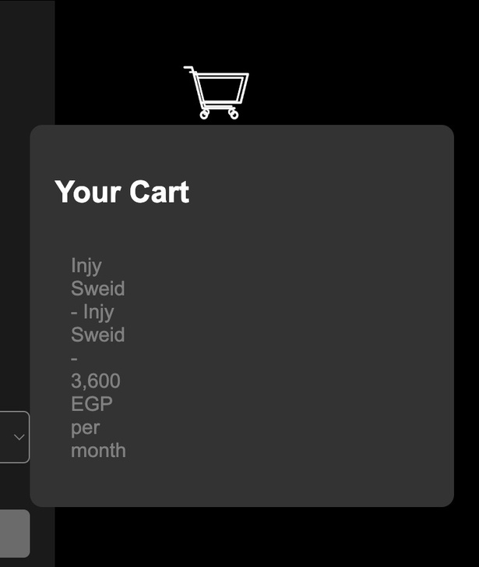
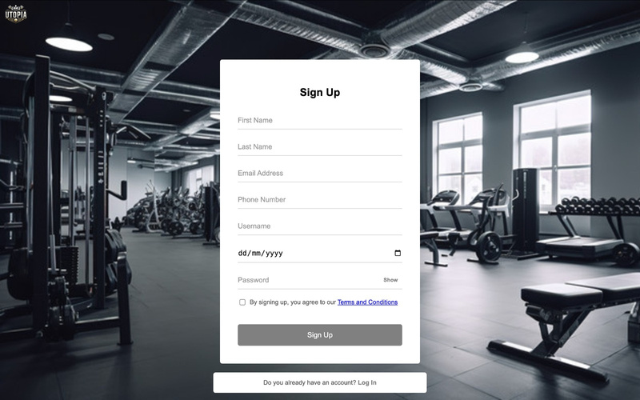

UTOPIA
Home
Photo
About Us
Contact
GYM MISSION
make gym booking easier and faster by providing images and enough information about the gym on the site
01
UTOPIA
make accessing your gym information safer and more secure
02
giving you a gym experience at home if you are not able to go to the locations themselves
03
06

Slide 7

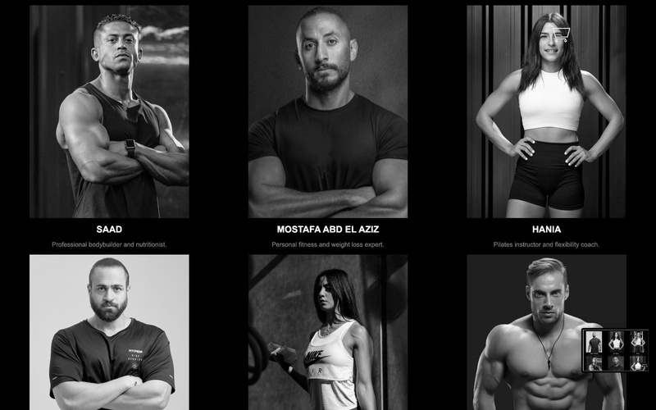
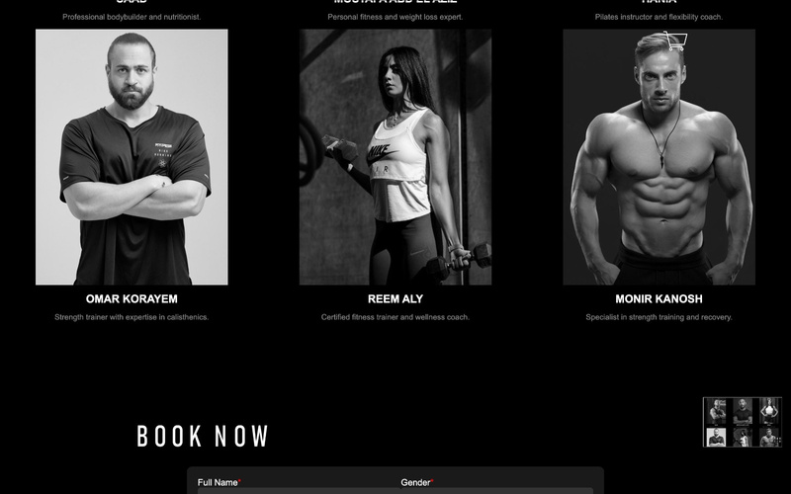
UTOPIA
Home
Photo
About Us
Contact
MEET OUR TRAINER
07

Slide 8
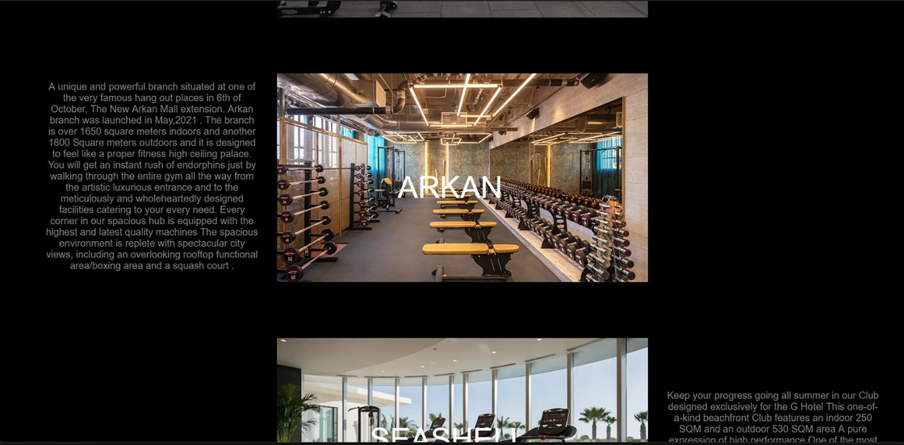
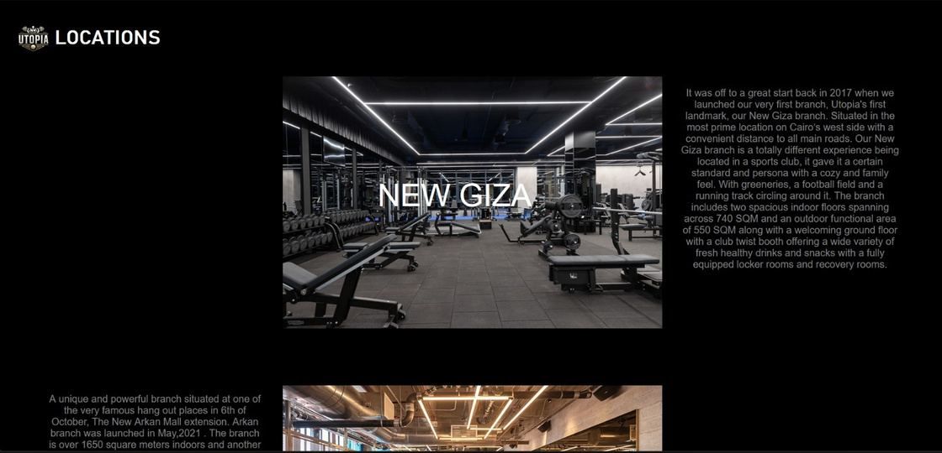
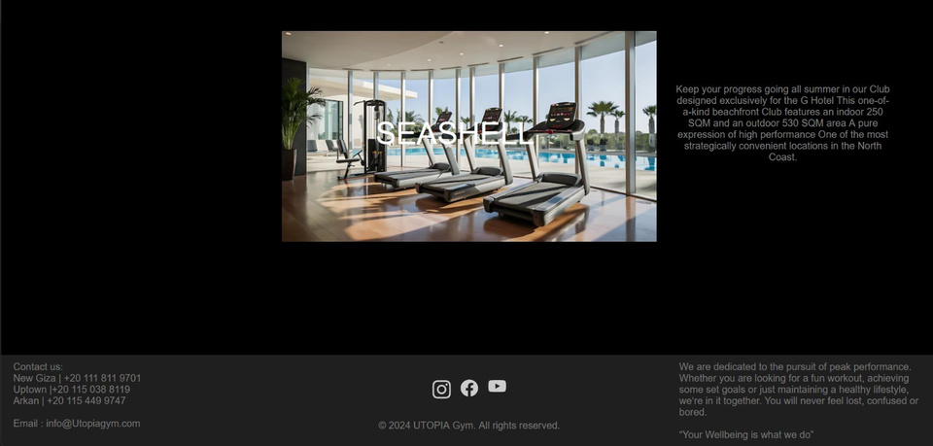
UTOPIA
Home
Photo
About Us
Contact
OUR LOCATIONS
08

Slide 9
UTOPIA
contributions
Team Leader: Erfan Nada
Mohamed Ammar
Home Page
Creation of tables on PHP My Admin for database connection
Login and Sign-up page
PHP code for database connection
Anan Khaled
Fajr Reda
Locations Page
Trainer Booking Page
03

Slide 10

UTOPIA
Home
Photo
About Us
Contact
THANK YOU
09

